Slide 1
WorkoutPlanSite

Slide 2


OUR TEAM
Ivan Zlatinov
Backend developer
Yavor Stoykov
Frontend
developer

Slide 3








USED PROGRAMS
Code & Collaborative Service
Design
Project Development
Presentation and Communication

Slide 4
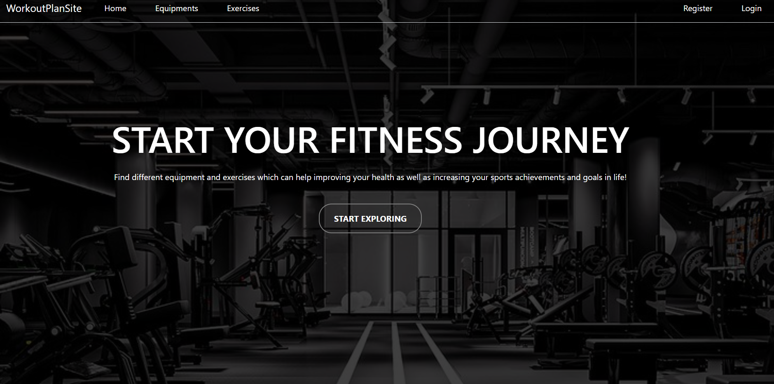
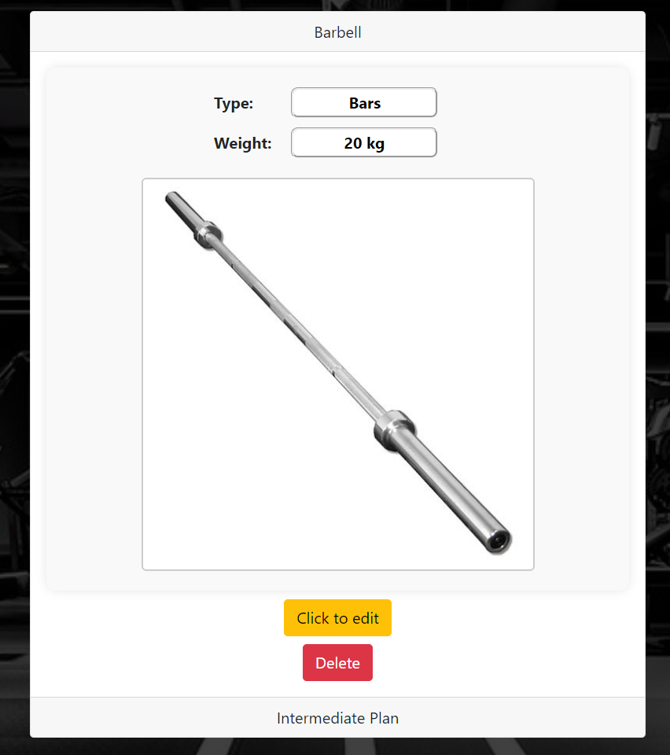
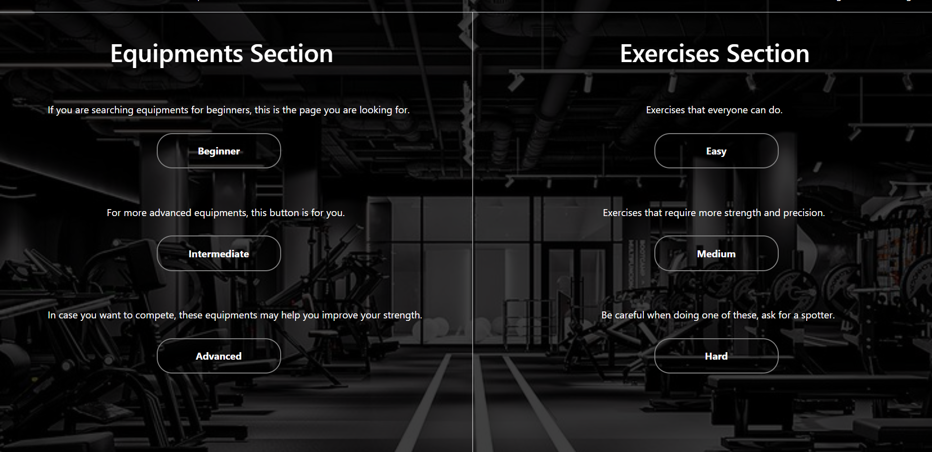
OUR IDEA

Slide 5
NOW LET’S GET TO THE PROJECT!

Slide 6
THANK YOU FOR THE ATTENTION

